Slide 1

Ch. 11
GOVERNMENT FAILURE
Lecture Slides
Presented by Dr. Edward C. Hoy
Notes:
These slides contain content from “Chapter 11: Government Failure” and includes supplementary material intended for class discussions and additional real world examples.

Slide 2

GOVERNMENT FAILURE & LIMITATIONS
CHAPTER 11
GOALS
List common sources of government failure.
Consider the outcomes of public choice.
Speak broadly about the size, scope, and role of government in the economy.
KENNESAW STATE UNIVERSITY | COLES COLLEGE OF BUSINESS

Slide 3
GOVERNMENT FAILURE & LIMITATIONS
GOVERNMENT FAILURE
(Total Social Surplus (CS + PS) is decreased because of government intervention in a market)
Two Broad Causes of Government Failure
Important tasks performed inefficiently.
Perform tasks outside the scope of gov.’s responsibilities.
Government Failure is best examined using …
Public Choice Tools
KENNESAW STATE UNIVERSITY | COLES COLLEGE OF BUSINESS
Notes:
See pg. 255 in the textbook for the definition of government failure.

Slide 4
GOVERNMENT FAILURE & LIMITATIONS
PUBLIC CHOICE
Subfield of Economics
Analyzes issues that historically fall within the domain of political science.
KENNESAW STATE UNIVERSITY | COLES COLLEGE OF BUSINESS

Slide 5
GOVERNMENT FAILURE & LIMITATIONS
_______ is the academic subfield which uses the tools/ framework of economics to analyze issues which traditionally fall within the domain of political science.
A. Public choice
B. Industrial Organization
C. Real Business Cycle Theory
D. Environmental Economics
KENNESAW STATE UNIVERSITY | COLES COLLEGE OF BUSINESS
Notes:
Answer: A

Slide 6
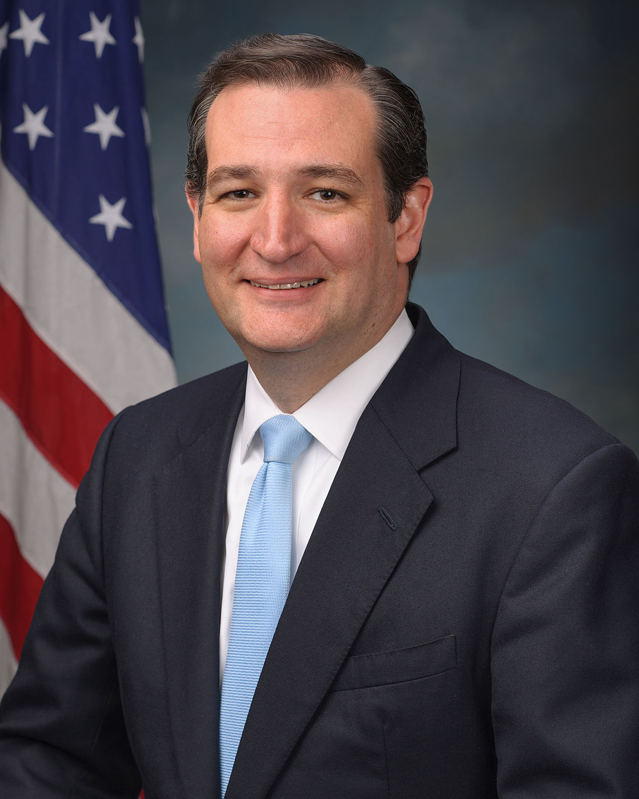
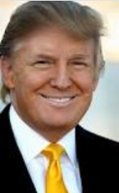
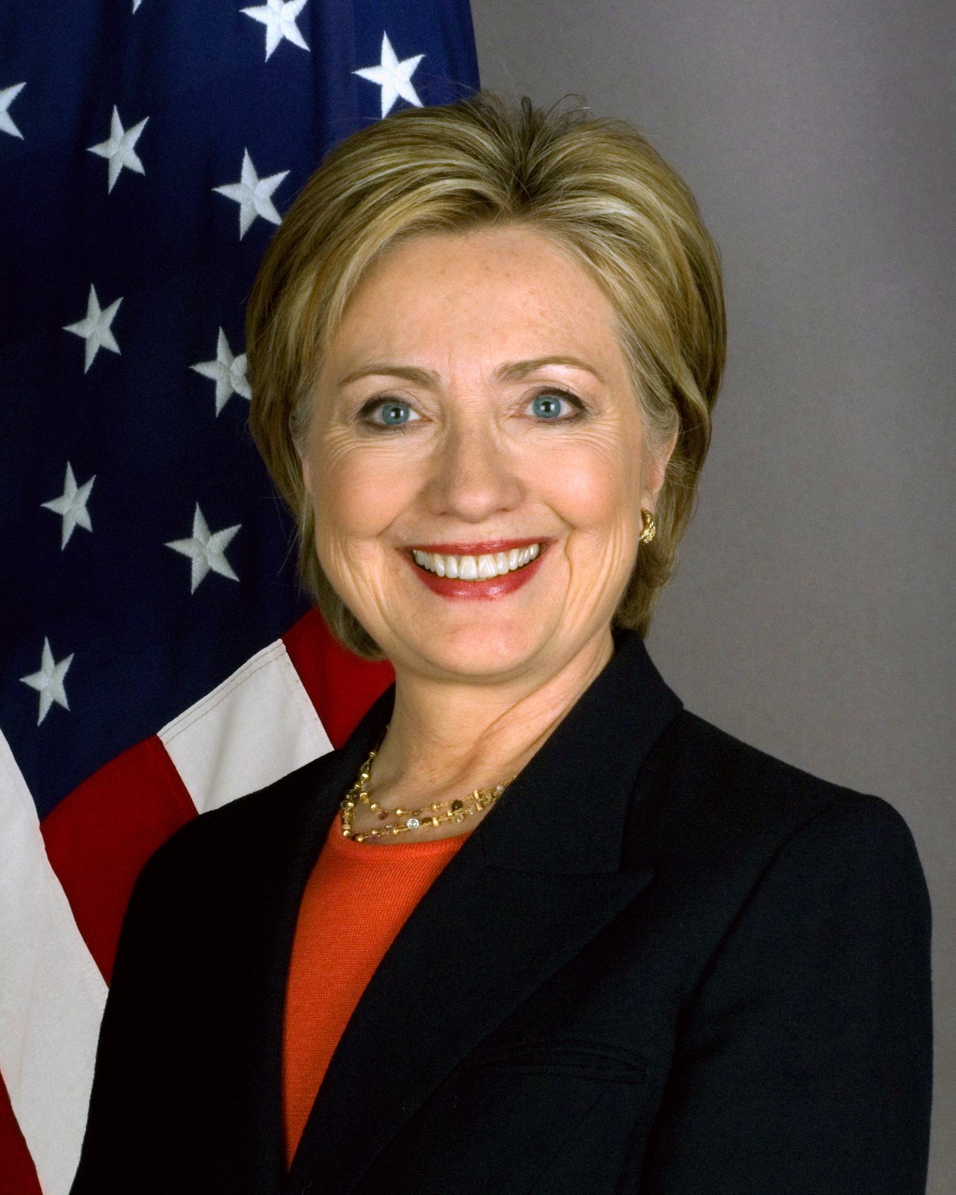
GOVERNMENT FAILURE & LIMITATIONS
CONSIDER THE FOLLOWING MODEL OF VOTING:
THREE CANDIDATES:
KENNESAW STATE UNIVERSITY | COLES COLLEGE OF BUSINESS
Notes:
Imagine that Donald, Hillary, and Ted (denoted D, H, and T) are seeking a public office.

Slide 7
GOVERNMENT FAILURE & LIMITATIONS
Assume voters …
choose the winner by a democratic process.
votes truthfully or sincerely (according to their actual preferences).
Q: Which candidate will be elected?
A: Depends on “voting process” & “rules” used to decide how the winner is elected.
KENNESAW STATE UNIVERSITY | COLES COLLEGE OF BUSINESS
Notes:
The winner of the election will vary depending on which ballot system is used, and which rules are used to decide how the winner is selected.

Slide 8
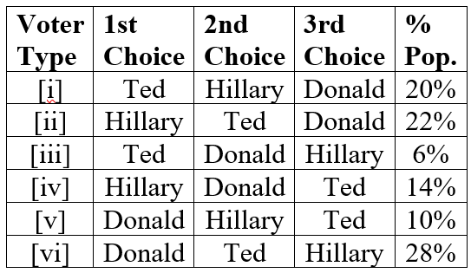
GOVERNMENT FAILURE & LIMITATIONS
Plurality of the Vote
[v] and [vi] vote for D => (10% + 28% = 38%) (Donald has a Plurality) [ii] and [iv] vote for H => (22% + 14% = 36%) [i] and [iii] vote for T => (20% + 06% = 26%)
Does This Outcome Reflect the “Will of the People?”
Donald has the plurality of votes, yet least preferred by the largest number (38% vs. 62% [= H’s 36% + T’s 26%]), of people
— “Voting process” is the method used to decide the winner —
KENNESAW STATE UNIVERSITY | COLES COLLEGE OF BUSINESS

Slide 9
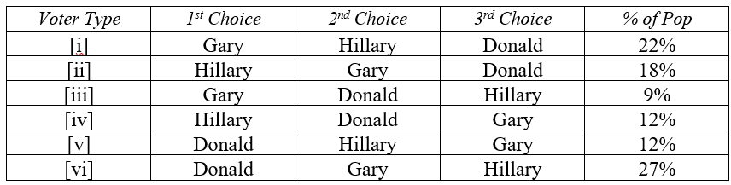
GOVERNMENT FAILURE & LIMITATIONS
Consider a situation in which three different candidates (Donald, Hillary, and Gary – denoted D, H, and G) are seeking an office. The person to fill the position will be decided by a vote. Voter preferences are summarized by the table below. Assume throughout that all people vote sincerely/truthfully (i.e., in-line with their actual preferences).
In an election between all three candidates, __________ would receive the most votes.
a. Donald c. Hillary
b. Gary d. None of the choices is correct.
ANS: A
1st Choice
Gary: 22% + 9% = 31%
Hillary: 18% + 12% = 30%
Donald: 12% + 27% = 39%
KENNESAW STATE UNIVERSITY | COLES COLLEGE OF BUSINESS

Slide 10
GOVERNMENT FAILURE & LIMITATIONS
Run-Off Between Top 2
No one got 50%⁺ of the votes, so we have a 2nd round of voting with only Donald and Hillary on the ballot result in the following…
[i], [ii], [iv] vote H => 20% + 22% + 14% = 56%
[iii], [v], [vi] vote D => 06% + 10% + 28% = 44%
Hillary wins in a ‘runoff ’ (56% to 44%).
Does this new process reflect the “will of the people”?
Depends on whether the electorate find a runoff acceptable
– “Rules” are used to decide how the winner is elected –
NOTE: both candidates add up the percentage of votes they received in the 2nd round + the win they had in the first round.
KENNESAW STATE UNIVERSITY | COLES COLLEGE OF BUSINESS

Slide 11
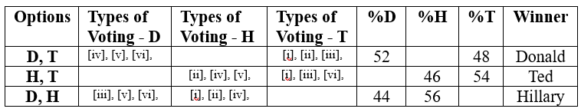
GOVERNMENT FAILURE & LIMITATIONS
TRANSITIVITY
of
PREFERENCE (1 > 2 & 2 > 3, then 1 > 3)
Do You Notice a Problem?
If Donald (1) is preferred to Ted (2), and Ted (2) is preferred to Hillary (3); then by the Transitive Property, Donald (1) should be preferred to Hillary (3).
Wait a Minute! Voting results of table indicate that Hillary beats Trump.
– “Voting Process” & “Rules” appears to be irrational in nature –
KENNESAW STATE UNIVERSITY | COLES COLLEGE OF BUSINESS

Slide 12
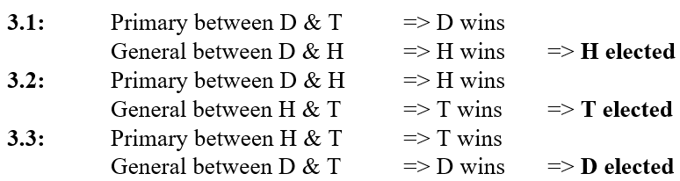
GOVERNMENT FAILURE & LIMITATIONS
(series pf primary rounds followed by general election between candidates)
WHAT IS THE PROBLEM WITH THIS VOTING PROCESS?
Allows a person to support a candidate who is ‘unlikely’ to win without preventing the election of another candidate that is likely to win
PAIRWISE ELECTIONS
Like the round-robin format used in sports tournaments, but hardly used for political elections.
The winner of each pairing is the candidate preferred by a majority of voters.
KENNESAW STATE UNIVERSITY | COLES COLLEGE OF BUSINESS

Slide 13
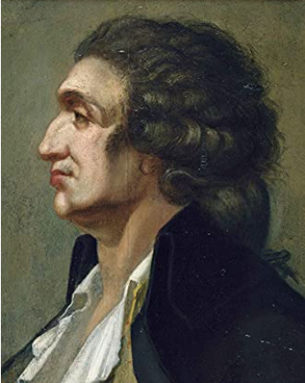
GOVERNMENT FAILURE & LIMITATIONS
Condorcet Paradox
“Series of multiple pairwise majority votes that lead to a never-ending cycling of winners.”
Never-ending cycle of winners reveals that social preferences are:
irrational (i.e., not clearly defined) since they are;
non-transitive (i.e., internally inconsistent or are internally contradictory).
Nicolas de Condorcet 18th century French philosopher/mathematician
KENNESAW STATE UNIVERSITY | COLES COLLEGE OF BUSINESS
Notes:
RESUME HERE.

Slide 14

GOVERNMENT FAILURE & LIMITATIONS
INDIVIDUAL PREFERENCES
Consider the following preferences for ice cream:
Chocolate > Vanilla;
Vanilla > Strawberry;
Strawberry > Vanilla;
These preferences are logically inconsistent.
“Will of the people” is meaningless.
Any attempt to identify a voting system that reveals the “will of the people” is futile.
KENNESAW STATE UNIVERSITY | COLES COLLEGE OF BUSINESS
Notes:
In such cases the “will of the people” is meaningless, so any attempt to identify a voting system that reveals the “will of the people” is futile.

Slide 15
GOVERNMENT FAILURE & LIMITATIONS
The ________________ refers to a situation in which a series of pair-wise majority votes over more than two options leads to a cycling of winners.
a. Condorcet Paradox c. Coase Conjecture
b. Buchanan Puzzle d. Shapley Value
ANS: A
KENNESAW STATE UNIVERSITY | COLES COLLEGE OF BUSINESS
Notes:
In such cases the “will of the people” is meaningless, so any attempt to identify a voting system that reveals the “will of the people” is futile.

Slide 16
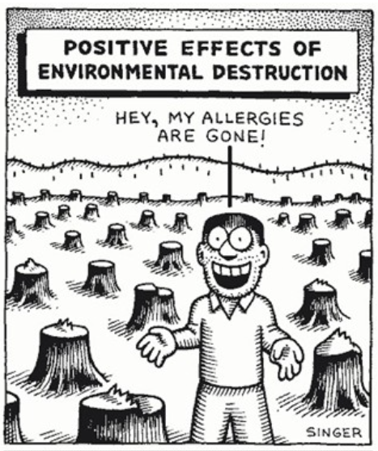
GOVERNMENT FAILURE & LIMITATIONS
7 Specific Sources of Government Failure
KENNESAW STATE UNIVERSITY | COLES COLLEGE OF BUSINESS

Slide 17
GOVERNMENT FAILURE & LIMITATIONS
1. Informational Problems
To Set Policy …
Gov. must find the efficient level of trade;
Need substantial amount of information. However, …
individuals that are harmed by negative externality have an incentive to overstate the magnitude of the damage.
individuals may exaggerate the benefits from public goods, if they do not have to incur the full costs of the goods.
“Bureaucrat can be led astray when private citizens misrepresent the true cost of the externality.”
KENNESAW STATE UNIVERSITY | COLES COLLEGE OF BUSINESS
Notes:
When buyers and sellers make decisions in markets, they generally have incentives to truthfully reveal their benefits and costs
However, this is not the case when we abandon or cannot rely upon markets
Consequently, even a well-intentioned government bureaucrat can be led astray when private citizens misrepresent their true benefits or costs from different policies

Slide 18
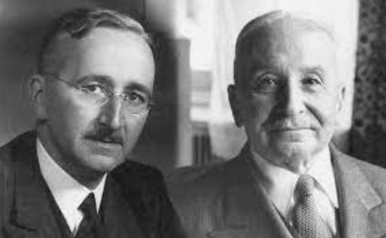
GOVERNMENT FAILURE & LIMITATIONS
ECONOMIC CALCULATION PROBLEM
“A system of planning will never be able to achieve efficient outcomes, because planners do not have the information generated by market activities available to them”
Ludwig von Mises
Friedrich von Hayek.
KENNESAW STATE UNIVERSITY | COLES COLLEGE OF BUSINESS
Notes:
Argument first made by Ludwig von Mises and later refined by Friedrich von Hayek

Slide 19
GOVERNMENT FAILURE & LIMITATIONS
2. Cost of Govt Compliance
Governments impose regulations,but;
It costs consumers vital resources to comply with policy.
“There is a complex, irrational, almost incomprehensible system of controls and licenses under which everything needs approval.”
Permit Raj
We appear to be saying that too much bureaucracy adds to higher costs of compliance.
KENNESAW STATE UNIVERSITY | COLES COLLEGE OF BUSINESS
Notes:
The Cost of Complying with Government Bureaucracy (See pg. 261).

Slide 20
GOVERNMENT FAILURE & LIMITATIONS
The Cost of Starting a Business:
Venezuela:
17 procedures, 144+ days.
Cost: 88.7% of annual per capita income.
New Zealand:
1 procedure, ½ a day,
Cost: 0.3% of annual per capita income.
KENNESAW STATE UNIVERSITY | COLES COLLEGE OF BUSINESS
Notes:
Recall the “The Ease of Doing Business” Study.

Slide 21
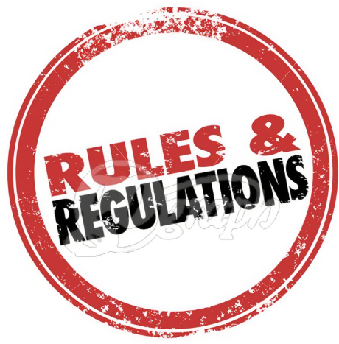
GOVERNMENT FAILURE & LIMITATIONS
3. Corruption
Regulations are not enforced;
Decisions not made;
Too much bias,
e.g. Government contract for a bridge:
Contractor ‘A’ has costs of $18M,
Contractor ‘B’ has costs of $21M.
Contractor ‘B’ may obtain the contract through bribes.
KENNESAW STATE UNIVERSITY | COLES COLLEGE OF BUSINESS

Slide 22
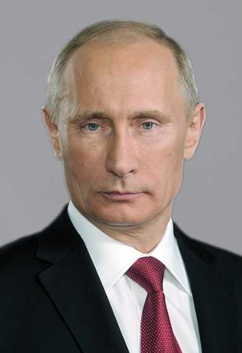
GOVERNMENT FAILURE & LIMITATIONS
3. Kleptocracy
Extreme corruption
Gov. officials shamelessly seek personal gain at the expense of the public interest.
e.g., Present-day Russia
“Small group of people wholly above the law, has in the past decade, become rich beyond the wildest dreams of the tsars.”
KENNESAW STATE UNIVERSITY | COLES COLLEGE OF BUSINESS

Slide 23
GOVERNMENT FAILURE & LIMITATIONS
In the textbook, ______________ was described as “an ill-governed kleptocracy in which corruption is not a happy side-effect of power, but the core of the system.”
a. present day India
present day Russia
the United States during the 1930s
d. Great Britain during the 1980s
ANS: B
KENNESAW STATE UNIVERSITY | COLES COLLEGE OF BUSINESS

Slide 24
GOVERNMENT FAILURE & LIMITATIONS
4. Regulatory Capture
Governments often regulate…
producers that have too much market power, or;
markets that lack information.
Industry that is being regulated …
has a strong incentive to influence the decisions of the regulatory body.
e.g. of regulatory body—Food and Drug Administration (FDA) approves for prescription drugs in the U.S.
KENNESAW STATE UNIVERSITY | COLES COLLEGE OF BUSINESS
Notes:
Regulators often identify more with those in the industry being regulated than with the general public (perhaps from movement back and forth of people between working in the industry versus as a regulator).

Slide 25
GOVERNMENT FAILURE & LIMITATIONS
5. Rent-Seeking
Attempts to manipulate or influence government actions & decisions to make oneself better off at the expense of others.
Domestic industry/workers have an incentive to lobby hard to protect their industry from competition.
e.g., U.S. trade restrictions on imported peanuts. Ultimately, consumers pay higher prices.
KENNESAW STATE UNIVERSITY | COLES COLLEGE OF BUSINESS

Slide 26
GOVERNMENT FAILURE & LIMITATIONS
Cost of Rent-Seeking:
Estimated annual impact of U.S. peanut quota:
Jobs saved = 397
Cost per job saved = $187,223
How does this clearly inefficient subsidy with benefits for so few people get enacted?
Why would Congressman from Ohio, California, Oregon, and Wisconsin vote to save 397 jobs in Georgia, Alabama, and Texas at a cost of $187,223 per job!?
KENNESAW STATE UNIVERSITY | COLES COLLEGE OF BUSINESS

Slide 27
GOVERNMENT FAILURE & LIMITATIONS
6. Logrolling
Legislator votes to approve one bill in exchange for favorable votes from other members on other bills.
Not necessarily a “bad thing” - logrolling can be potentially beneficial, expressing an “intensity of preference.”
However, logrolling tends to have inefficient outcomes for society when voters are rationally ignorant.
KENNESAW STATE UNIVERSITY | COLES COLLEGE OF BUSINESS

Slide 28
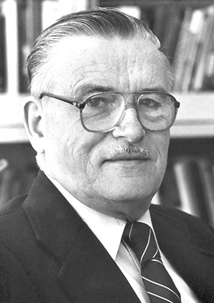
GOVERNMENT FAILURE & LIMITATIONS
James M. Buchanan
(1919-2013; Nobel Prize in 1986)
Argued that politicians in a democracy often act to maximize the probability of their reelection.
KENNESAW STATE UNIVERSITY | COLES COLLEGE OF BUSINESS

Slide 29
GOVERNMENT FAILURE & LIMITATIONS
Within our discussion of Logrolling, we noted that _______________ argued that politicians in a democracy often act to maximize the probability of their own re-election.
Ronald Coase
Gordon Tullock
James Buchanan
d. Jeremy Bentham
ANS: C
KENNESAW STATE UNIVERSITY | COLES COLLEGE OF BUSINESS

Slide 30
GOVERNMENT FAILURE & LIMITATIONS
___________ is the process by which a legislator votes to approve one bill in exchange for favorable votes from other members on other bills.
A. Rational Ignorance
B. Regulatory capture
C. Rent seeking
D. Logrolling
KENNESAW STATE UNIVERSITY | COLES COLLEGE OF BUSINESS
Notes:
Answer: D

Slide 31
GOVERNMENT FAILURE & LIMITATIONS
6. Rational Ignorance
Deliberate choice to pay NO attention to certain kinds of information because of the time & effort that yields little or no benefit.
or
Cost of acquiring information is greater than the benefits to be derived from the information – it is rational to be ignorant.
Examples:
Person who is not interested in politics may choose not to vote in an election because they believe that their vote will not make a difference.
Person who is not interested in cars may choose not to learn how to fix them because they believe that it is more cost-effective to pay someone else to do it.
Person who is not interested in cooking may choose not to learn how to cook because they believe that it is easier and more convenient to eat out or order food.
KENNESAW STATE UNIVERSITY | COLES COLLEGE OF BUSINESS
Notes:
Congressman from Ohio, California, Oregon, and Wisconsin want similarly inefficient trade protection for machine tools, canned tuna, softwood lumber, and dairy products voters in GA become informed about and recognize the local benefits of the trade protection for peanuts but remain rationally ignorant of the costs of all the other trade protections

Slide 32
GOVERNMENT FAILURE & LIMITATIONS
7. DWL from Taxes
Government spending is commonly financed through taxation.
Taxes create deadweight loss because they prevent consumers from buying a product that costs more after taxes, than it would before the tax was applied.
—Consider the following: “Tax A” is a $3 per unit tax imposed on buyers; “Tax B” is a $2 per unit tax imposed on sellers.
—We can infer that consumers would prefer “Tax B” over “Tax A.” Why? Because sellers ultimately pass on the taxes to consumers in higher prices.)
Excise Tax
A fixed dollar amount must be paid to the govt for unit of a good produced.
Govt’s goal: forces producers to make less goods that the govt deems dangerous or unwanted.
Incidence of Tax
measure of who bears the burden of the tax in terms of decreased economic surplus
KENNESAW STATE UNIVERSITY | COLES COLLEGE OF BUSINESS

Slide 33
GOVERNMENT FAILURE & LIMITATIONS
If a per unit tax is placed on sellers of a product, the “price ultimately paid by buyers” ____________, while the “price ultimately received by sellers” ____________.
increases; remains unchanged.
remains unchanged; decreases.
increases; increases.
increases; decreases
ANS: D
KENNESAW STATE UNIVERSITY | COLES COLLEGE OF BUSINESS
33

Slide 34
GOVERNMENT FAILURE & LIMITATIONS
Which of the following is NOT one of the seven sources of government failure?
A. Corruption or kleptocracy
B. Regulatory capture
C. Rent seeking
D. Externalities
KENNESAW STATE UNIVERSITY | COLES COLLEGE OF BUSINESS
Notes:
Answer: D

Slide 35
Some slides were generated by Daniel Forsberg
GOVERNMENT FAILURE
Notes:
End of slides.

Slide 36
